Slide 1
SQL data exploration
Coronavirus - covid 19

Slide 2
objective
Make some basic data exploration on SQL to understand a given data set.

Slide 3
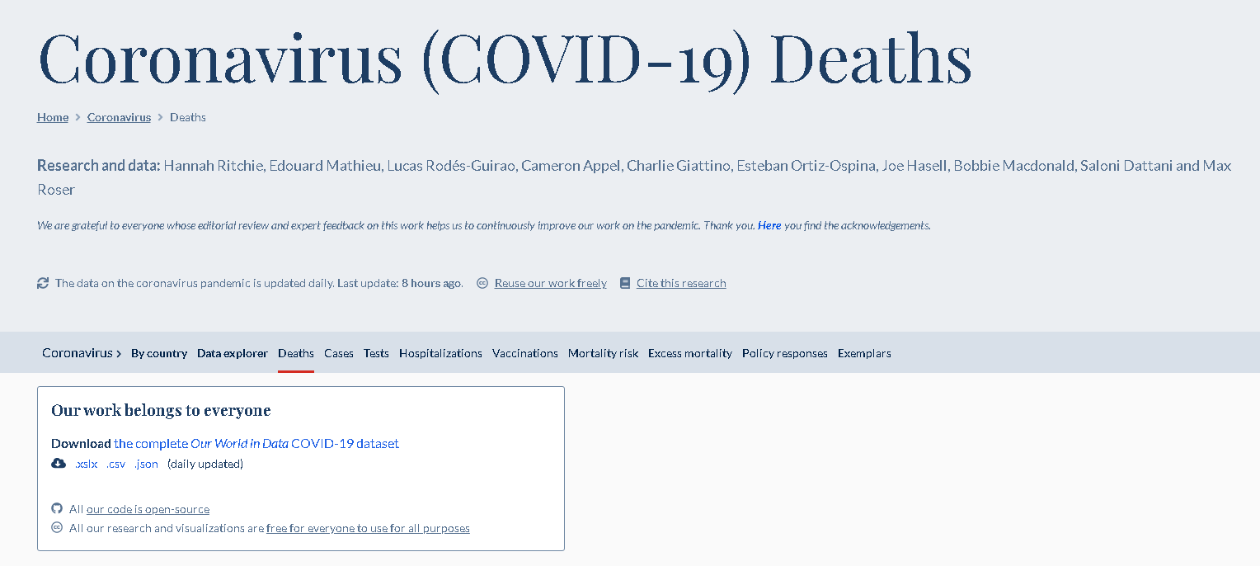
Data set
Data taken from https://ourworldindata.org/covid-deaths about Covid 19 deaths around the globe from 01/01/2020 to 03/03/2022
And guide made by Alex the Analyst in the video SQL Data Exploration

Slide 4
Data set manipulation
We created two different data sets from the original data, one that containts the deaths data and the other containts the vaccination data.
This with the aim to make some joins in SQL.

Slide 5
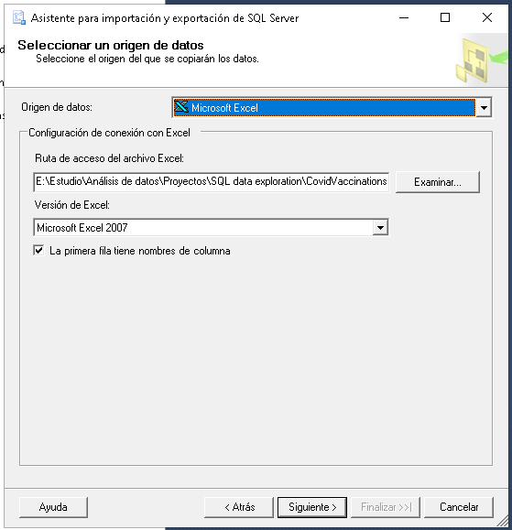
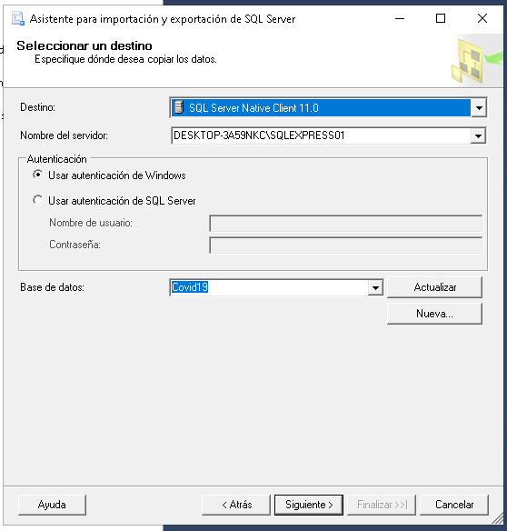
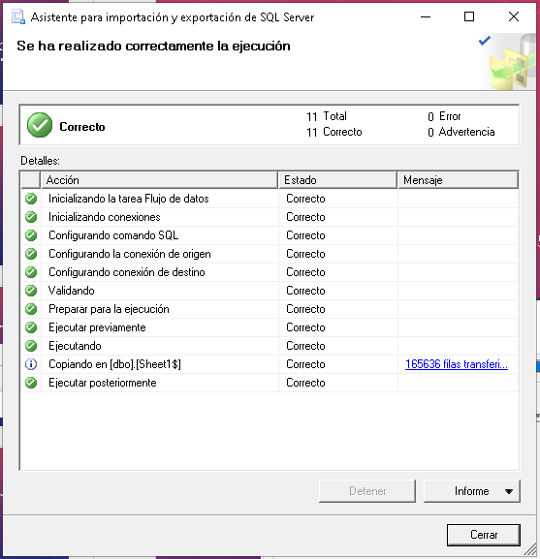
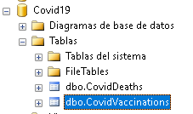
Data load
We loaded the data set on Microsoft SQL Server in two different tables.

Slide 6




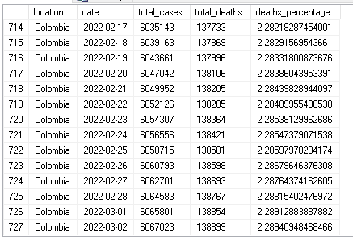

SQL queries
Query all the CovidDeaths data order by location and then for date.
Query the columns we are interested
Calculating the deaths_percentage at Colombia, we have to the 2022-03-02 a total of 6.067.023 cases with a deaths percentage of 2.29%

Slide 7
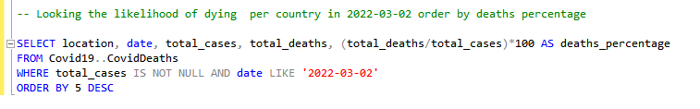
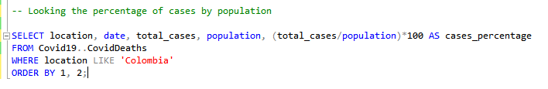
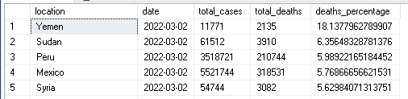
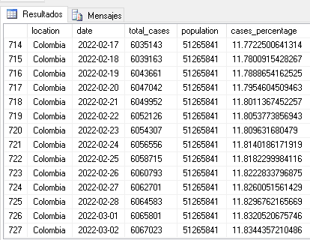
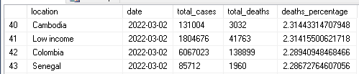
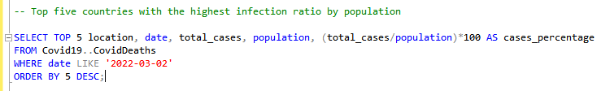
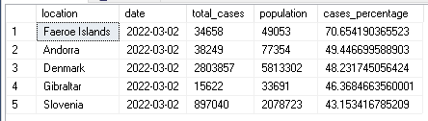
Colombia is at Rank 47 of countries with more deaths percentage.
Almost the 11.8% of the population in Colombia have had Covid
The top five countries by cases percentage for the total population are countries with low population.

Slide 8
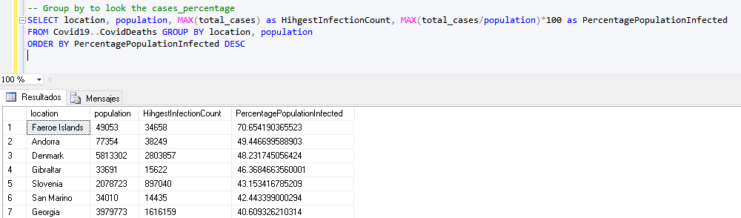
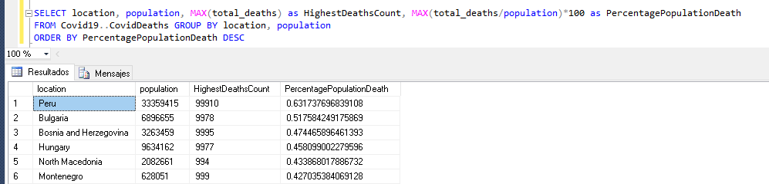
Group by for looking the cases percentages
Showing the countries with highest death count by population
Here we can see that the top countries per percentage deaths by population are south European countries, and the highest rate is for Peru.

Slide 9
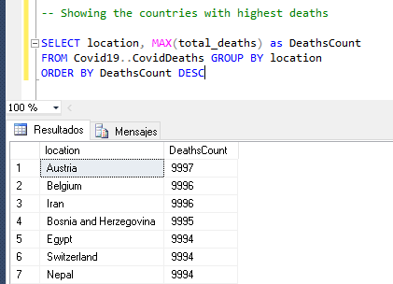
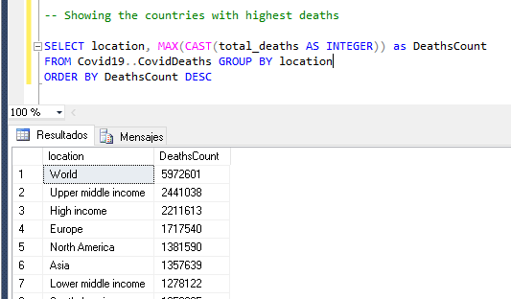
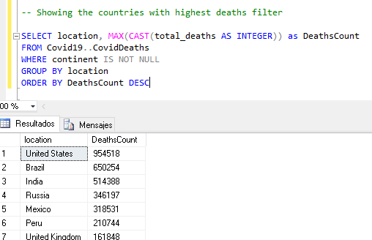
Quering the data we can see an error, the total_deaths atrribute has been define as Varchar, so we can use CAST function to used it as an integer.
Querying the data we can see an error, we have aggrupations for continents, region and income. So we have to filter the data.
All this aggrupations does not have a value in continent.
So the top three countries by deaths are USA, Brazil and India.

Slide 10
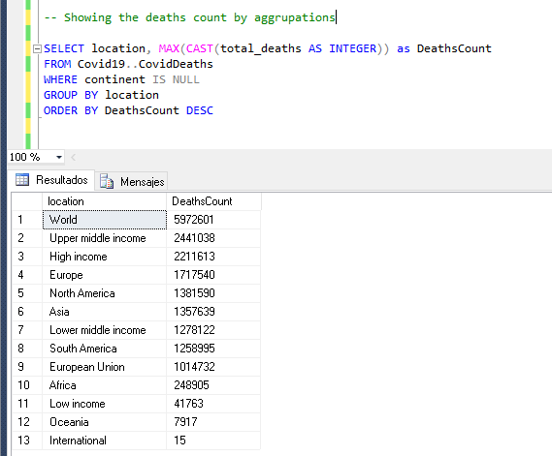
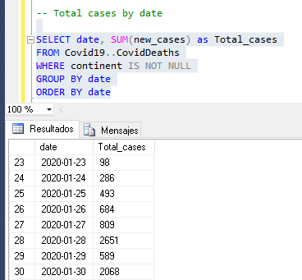
Breaking Down the deaths count by aggrupations, we can see the total deaths on the world and Europe, as continent, has the highest quantity.
Now we want to know the total cases by date

Slide 11
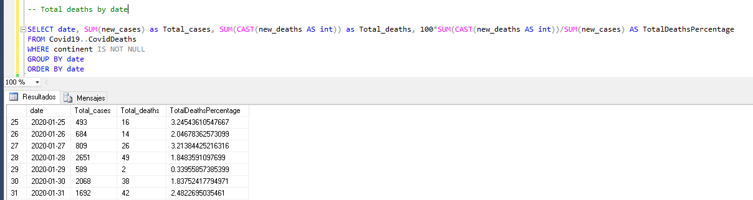
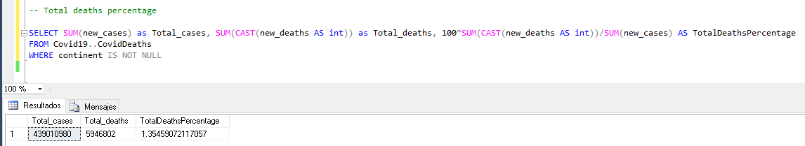
Now we calculate the total deaths percentage by date
The total deaths percentage is 1.35% to the date.

Slide 12
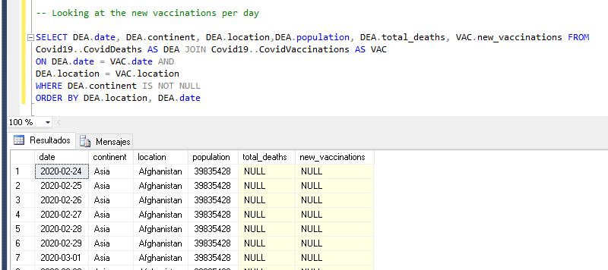
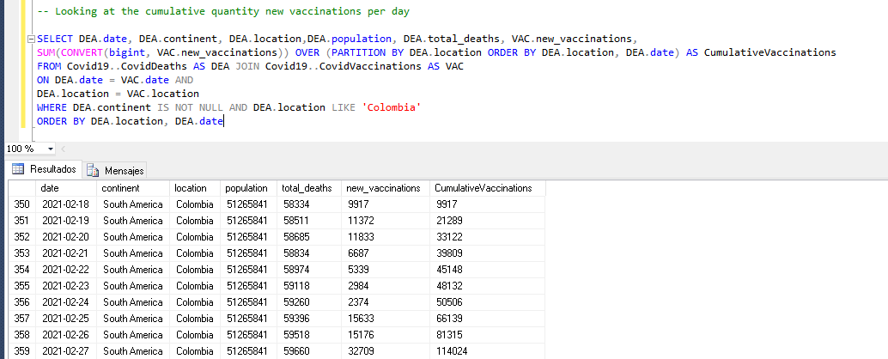
Join the two tables to see the new vaccinations per day
Looking at the cumulative quantity new vaccinations per day in Colombia

Slide 13
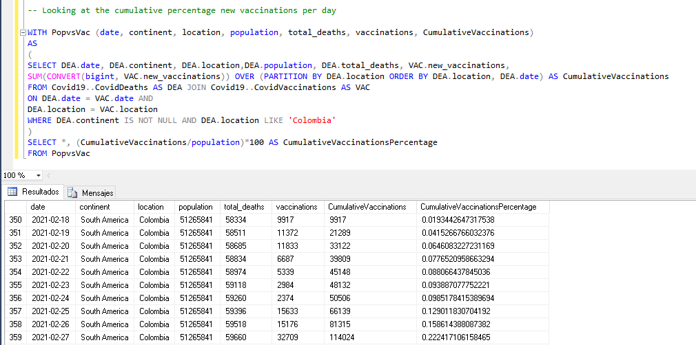
Calculation of the accumulated percentage of vaccinations

Slide 14
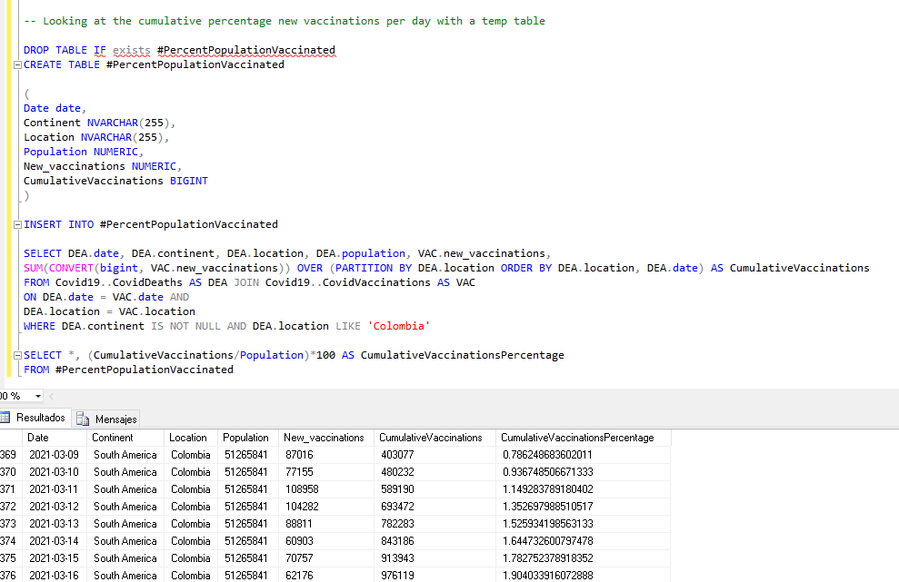
Calculation of the accumulated percentage of vaccinations with a temp table

Slide 15
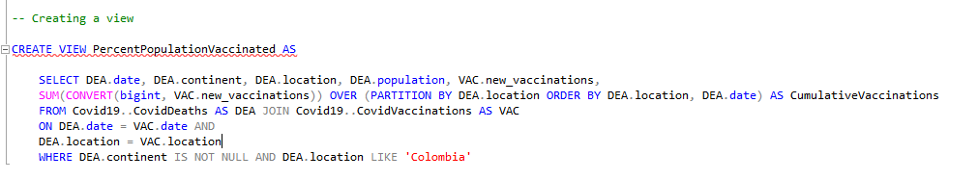

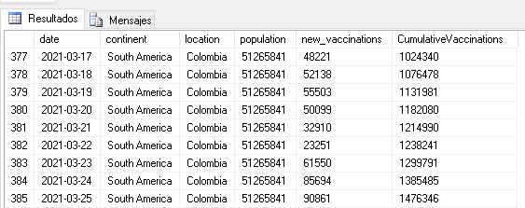
Creating a view to be used in data visualization

Slide 16
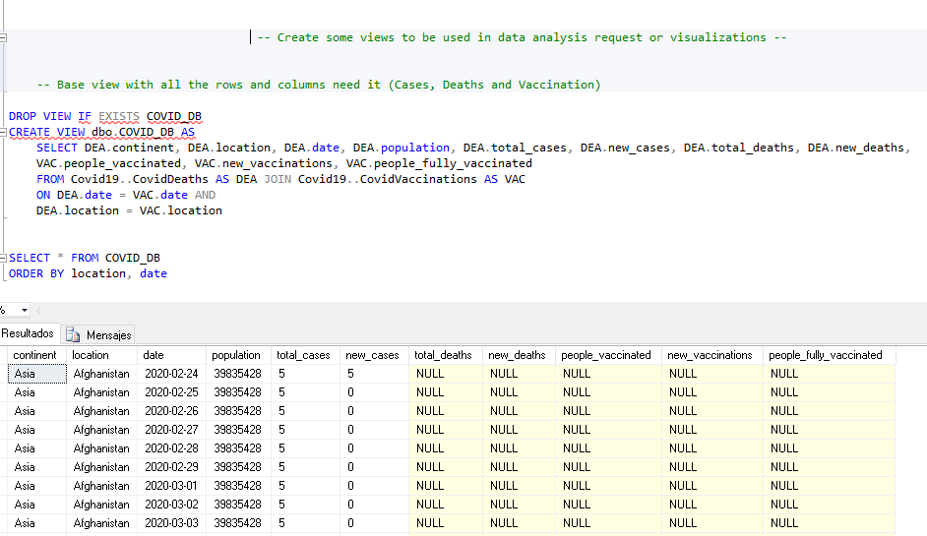
Views creation for data analysis

Slide 17
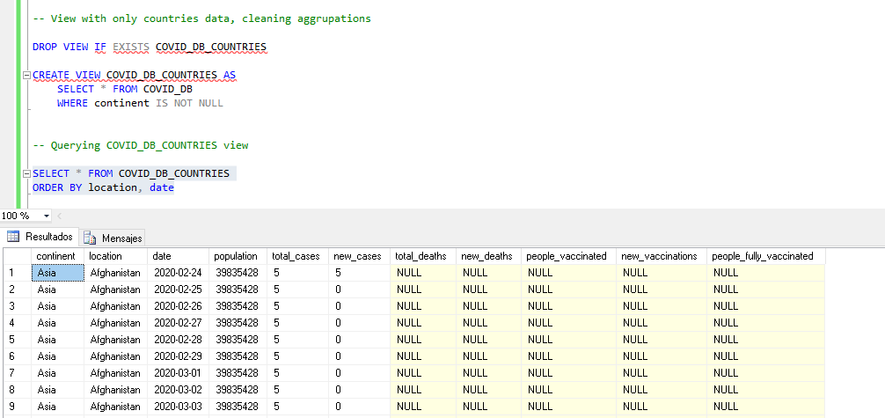
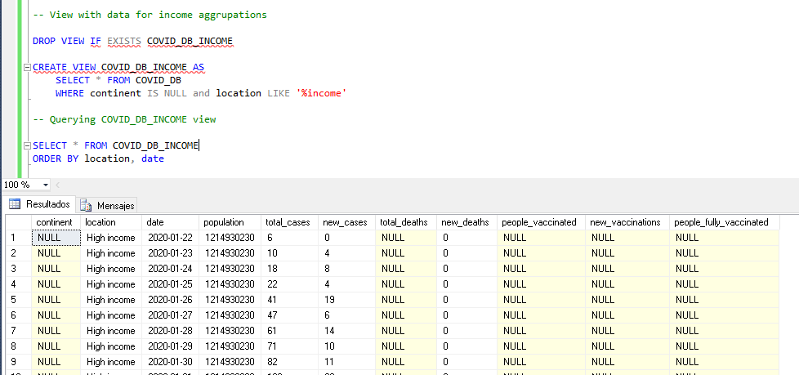
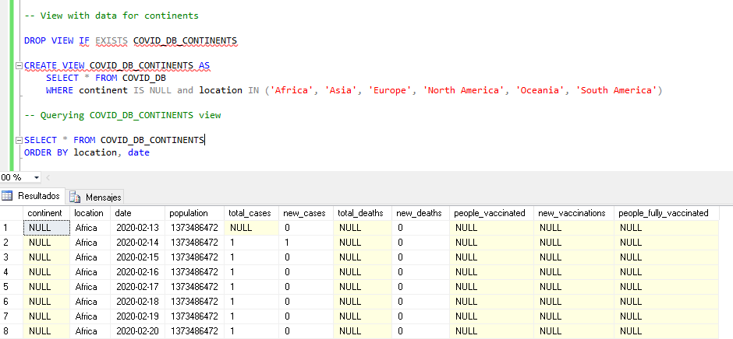
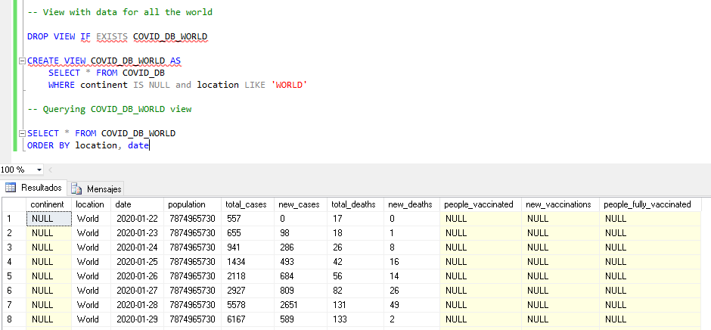

Slide 18
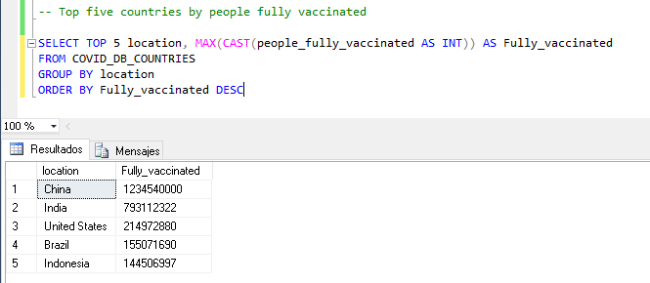
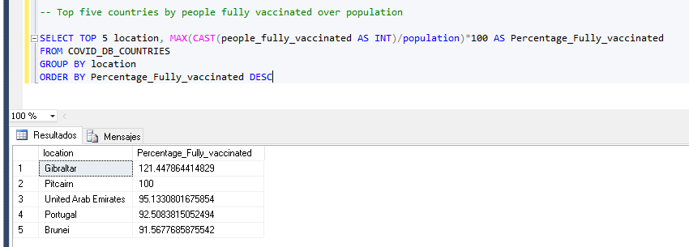
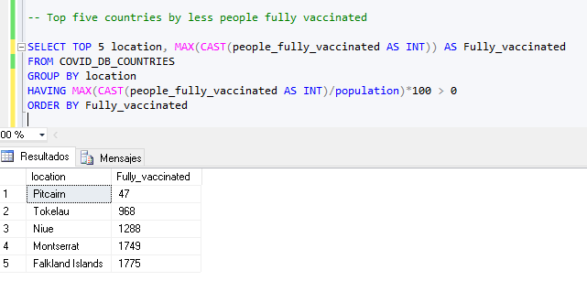
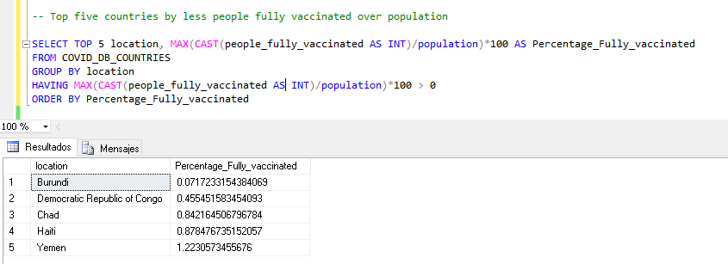
Some analysis by country
Top five countries by people fully vaccinated
Top five countries by people fully vaccinated over population
Top five countries by less people fully vaccinated NOT NULL
Top five countries by less people fully vaccinated over population NOT NULL

Slide 19
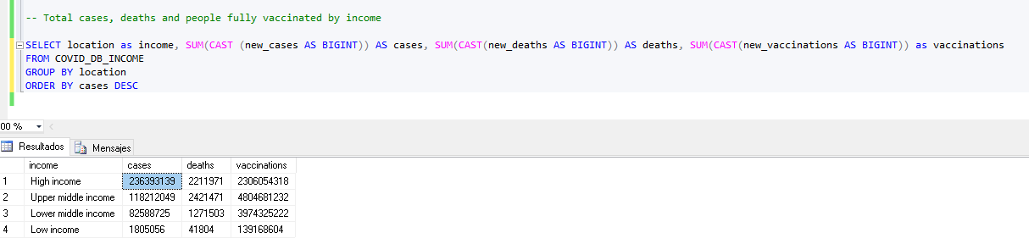
Some analysis by INCOME
Total cases, deaths and people fully vaccinated by income

